Slide 2
Introduction
Glenaree Solar Farm is a proposed solar project in the townlands of Cloncurry, Cappanargid, Barnaran, Glenaree, Feighcullen and Drumsru Co Kildare.
GP JOULE is a European renewable energy developer and independent power producer committed to developing high-quality solar PV farms and generating electricity in line with the principles of sustainable development, harnessing the most renewable resource: the sun.
This proposal aims to support Ireland in meeting its 2050 Net Zero target, while also enhancing energy security and price stability by reducing reliance on imported fossil fuels and mitigating their harmful environmental impact.

Slide 3
Proposed Development
The proposed solar farm known as ‘Glenaree Solar Farm’ is to be located in the townlands of Cloncurry, Cappanargid, Barnaran, Glenaree, Feighcullen and Drumsru Co. Kildare. It comprises approximately 140ha of agricultural land, which is serviced by the regional road, R414 and surrounded by mature hedgerows it will also include a 110kV Substation and Grid Connection.
The Glenaree Solar Farm is approximately 3km north-east of Rathangan. To maximize solar energy output, rows of solar panels will be placed in rows on the site in a south-facing orientation. The rows of panels will be 2.96m in height and are not expected to be visible beyond the site’s boundaries which consist of a mixture of dense mature hedgerows and mature trees, all of which are to be preserved and further strengthened by additional landscaping planting where required. The rows of solar panels will be spaced at least 3.5m apart. Panels will be placed horizontally across the site facing south to absorb energy from the sun to generate clean green renewable energy to help us to reduce emissions, become carbon neutral, and to displace harmful fossil fuels that are having such a detrimental impact on our environment and health. The distribution of panels will be kept to a minimum, leaving designated areas free for the promotion of biodiversity on site.

Slide 4
Summary of Proposed Development
110 MW solar PV project.
35-year operational lifespan.
AIS transmission substation.
Underground cable to grid.
Connection to EirGrid network

Slide 5
Site Description
The proposed development comprised of Planning permission for a duration of 10 years, with an operational life of 35 years from the date of commissioning. The proposed development comprises the construction and operation of a solar photovoltaic (PV) farm on a site of approximately 140 hectares. Proposed 110Mw Solar Photovoltaic Farm. A new three-bay 110 kV loop-in air-insulated switchgear (AIS) transmission substation and associated Independent Power Producer (IPP) substation at Glenaree, County Kildare; An underground 110 kV electricity transmission cable connecting to the proposed loop-in substation. All associated electrical plant and ancillary works necessary to facilitate connection to the EirGrid transmission network.
The development is intended to facilitate the export of electricity generated by the proposed Glenaree Solar Farm, with medium-voltage output stepped up to 110 kV for transmission purposes.

Slide 6
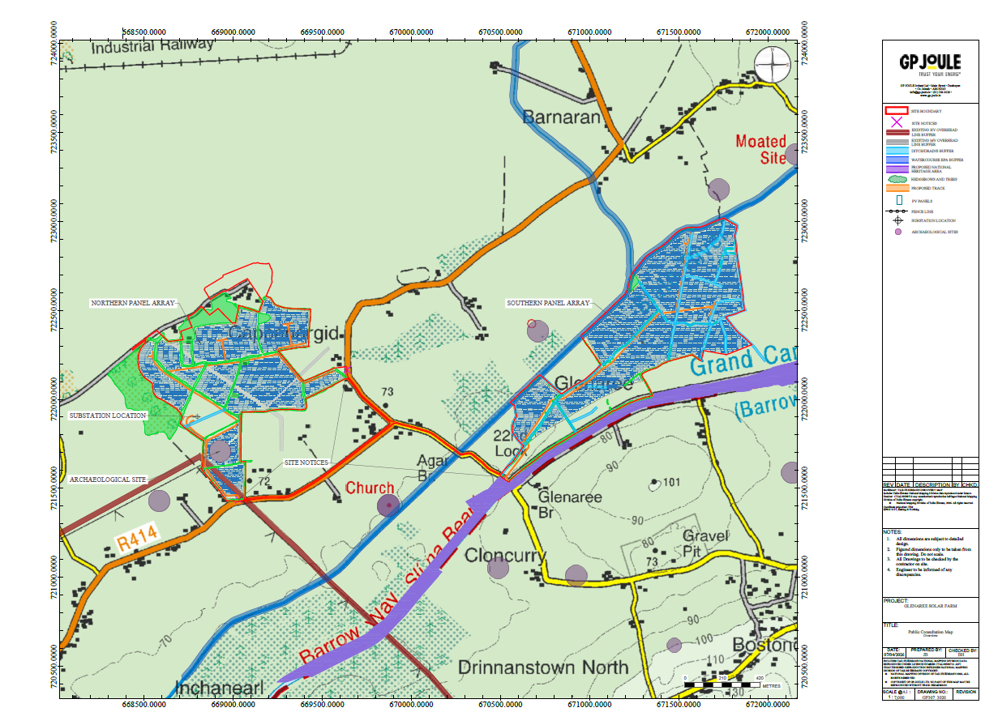
Site Location

Slide 7
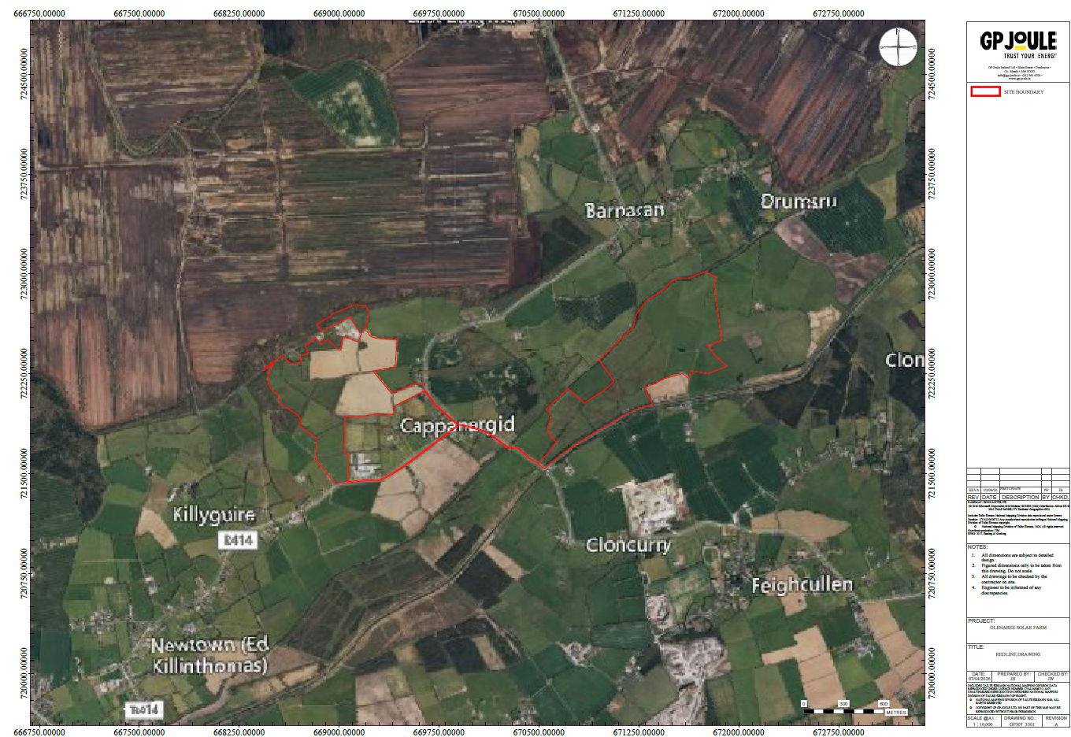
Redline Boundary

Slide 8
Benefits
Environmental: Reduced pesticide use, improved water quality, enhanced biodiversity.
Economic: €2/MWh annual Community Benefit Fund under RESS, managed locally with SEAI oversight.
Social: Construction jobs, ongoing site roles, regional procurement, and national contribution to renewable targets.
The project will help meet Ireland’s 2030 climate commitments, reduce emissions, and strengthen energy security.

Slide 9
Next Steps
Community Consultation – Engage with local residents and stakeholders to inform them of the project and gather feedback before submitting plans.
Planning and Submission – Prepare all required documentation and submit the application to the relevant local authority for review.
Engineer Design – Develop detailed technical drawings and specifications to meet planning requirements and industry standards.
Planning Process – The local authority assesses the application, seeks public and statutory comments, and decides to grant or refuse permission.

Slide 10
Proposed Application Content
The topics to be covered and submitted with this Application include the following Appendices:
Plans and Drawings;
Planning Statement incorporating Environmental Considerations;
Cultural Heritage Report;
Construction Environmental Management Plan;
Ecology Reports (NIS, EcIA and BMP);
Landscape Management Plan and A1 & A3 Landscaping Drawings;
Landscape and Visual Impact Assessment (LVIA);
Noise Assessment;
Glint and Glare Assessment;
Traffic Management Plan;
Flood Risk Assessment;
Statement of Community Consultation;
EIA Screening.

Slide 11
RED III
The proposal also aligns with EU renewable energy policy, including Directive (EU) 2023/2413 (REDIII), which recognises renewable energy projects and associated grid infrastructure as serving an overriding public interest and supports streamlined and proportionate permitting procedures.
RED III (Directive (EU) 2023/2413) is the EU’s updated Renewable Energy Directive, designed to accelerate the transition to clean energy. It sets a target of at least 42.5% renewable energy by 2030 and introduces measures to speed up the delivery of renewable projects. Importantly, it recognises renewable energy developments as being of overriding public interest, helping to streamline planning and permitting processes while supporting faster grid connections and reduced administrative barriers.
.

Slide 12
Questions?
.

